Slide 1


COVID-19 Disease transmission and economic impact
Team: silent titanic space python

Slide 2






Acknowledgements
This project would not have been possible without the collaborative efforts of our team members, mentors, and sponsors.
Dr. Alfred R. Watkins,
Academic Program Director & Senior
Assistant Professor,
Computer Science,
Morehouse College
Max Curie,
Research Assistant, Plasma Physics,
University of Texas at Austin
Abdul Mohammed,
Computer Science,
Winston-Salem State University
Vanessa Shogreen,
Student Research Assistant,
Computer Science,
Winston-Salem State University
Tyshawn Ferrell
Zyahn Archibald

Slide 3


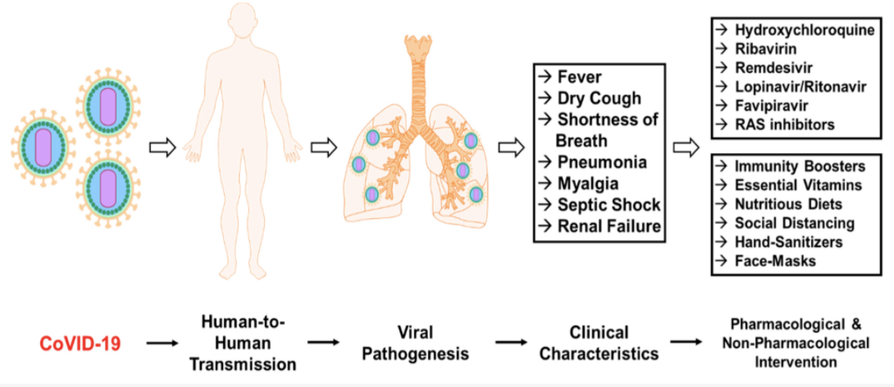
Introduction
Severe Acute respiratory Corona Virus 2 (sars-cov2) is the causative agent of COVID19, WHIch has caused more than 1 million deaths and 49 million infections worldwide.
SARs-cov2 is a highly infectious virus that can also infect susceptible domesticated animals through water droplets
Sars-cov2 infectivity is based on several factors including transmission and human intervention

Slide 4

Project overview

Slide 5
Project METHODS
Susceptibility, infection, recovery (sir) modeling
Heat mapping
Scatter plots of covid impact per economic status
Hpc computing technology using google cloud

Slide 6
Susceptibility, infection, recovery (sir) modeling
Add relevant text and graphics

Slide 7
Significance
Add relevant text and graphics

Slide 8
Heat mapping
Add relevant text and graphics

Slide 9
Significance
Add relevant text and graphics

Slide 10
covid impact per economic status
Add relevant text and graphics

Slide 11
Significance
Add relevant text and graphics

Slide 12
references
Georgia department of health
Emory university health equity dashboard

Slide 13
Live demonstration

Slide 14
Thank you

